Slide 1
RecSys Challenge 2019
Wei Lu, Kun Li, Bingyang Ye

Slide 2
Introduction
Based on customer’s preference, platform can recommend hotels to customers.
There are features like location, price, number of bathroom that customers care.
We need to extract features that predicate the correct hotel that customer would choose.

Slide 3
Purpose
The goal of the challenge is to use user signals within a session to detect the intent of the user and to update the recommendation of accommodations provided to the user. Given a dataset of the interactions of the users on our website and metadata for the items they interacted with, the participants are tasked with predicting what items have been clicked in the later part of a session.

Slide 4
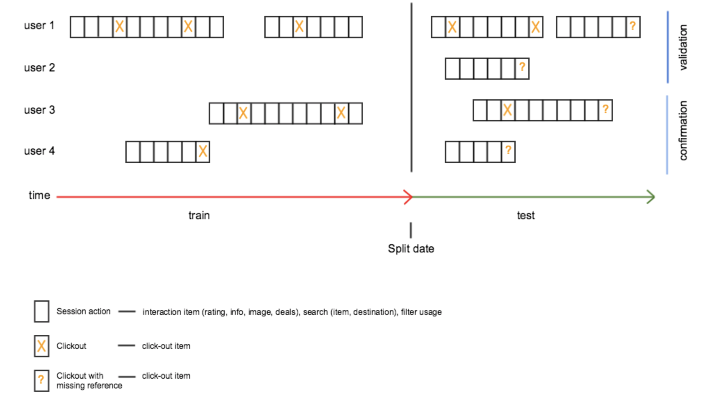
Data

Slide 5
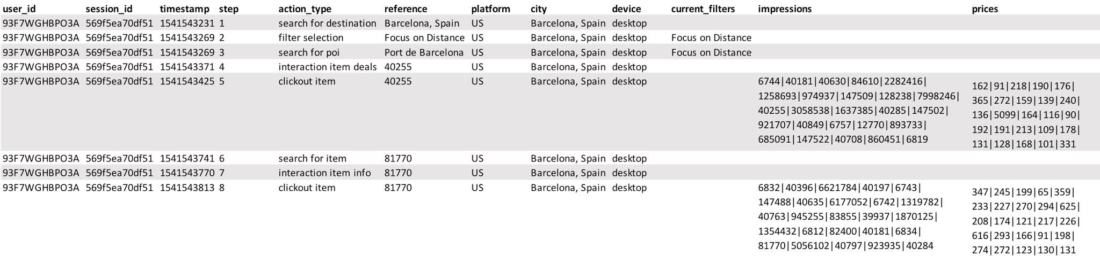
Data

Slide 6
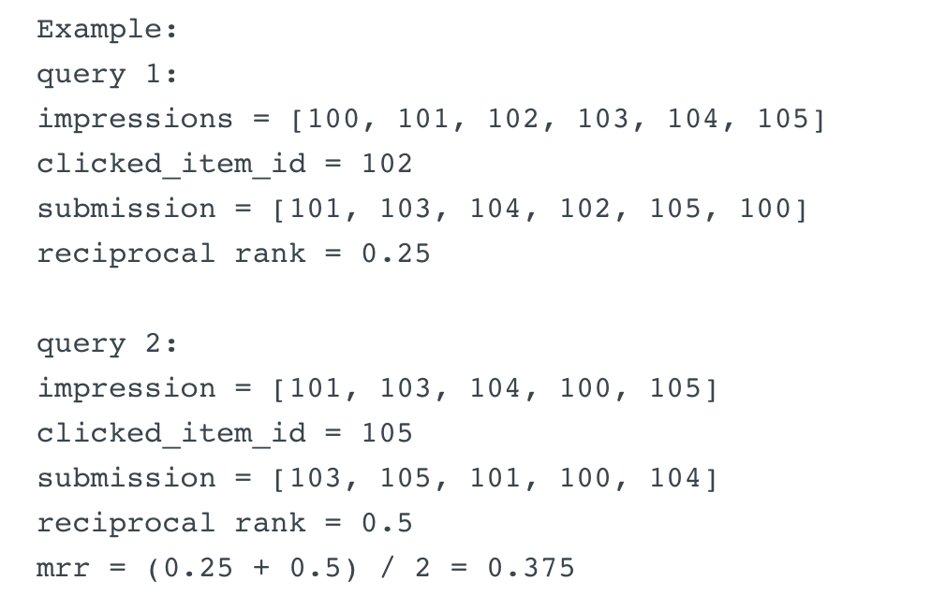
Evaluation
- Mean Reciprocal Rank

Slide 7
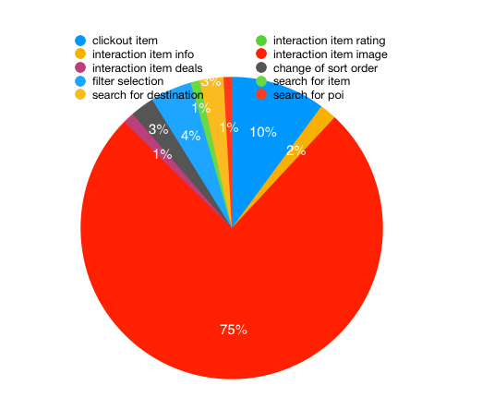

Slide 8
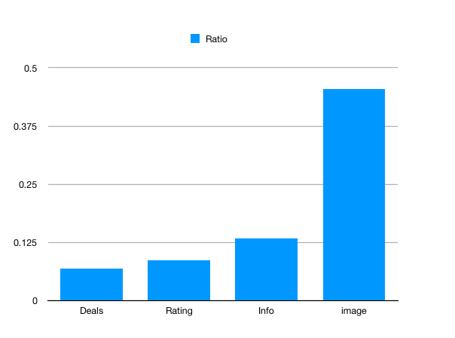

Slide 9
Baseline Algorithm
def get_popularity(df):
"""Get number of clicks that each item received in the df."""
def calc_recommendation(df_expl, df_pop):
"""Calculate recommendations based on popularity of items.
Drawback:
Haven’t considered personal preference.

Slide 10
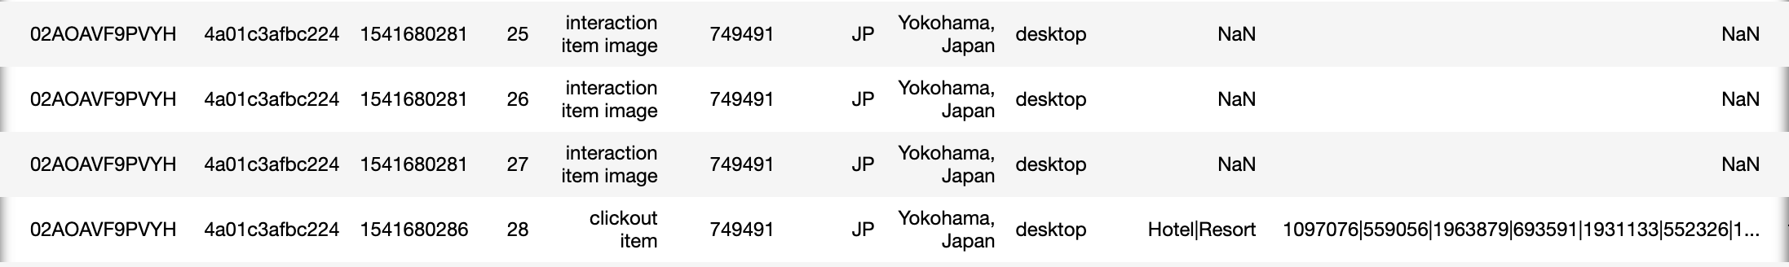
Refinement of baseline
Consider each user’s preceding actions:
Assumption 1:
If a user has taken actions (viewing images, ratings, deals .. ) on a hotel, it’s very likely that he/she will click out that hotel.

Slide 11
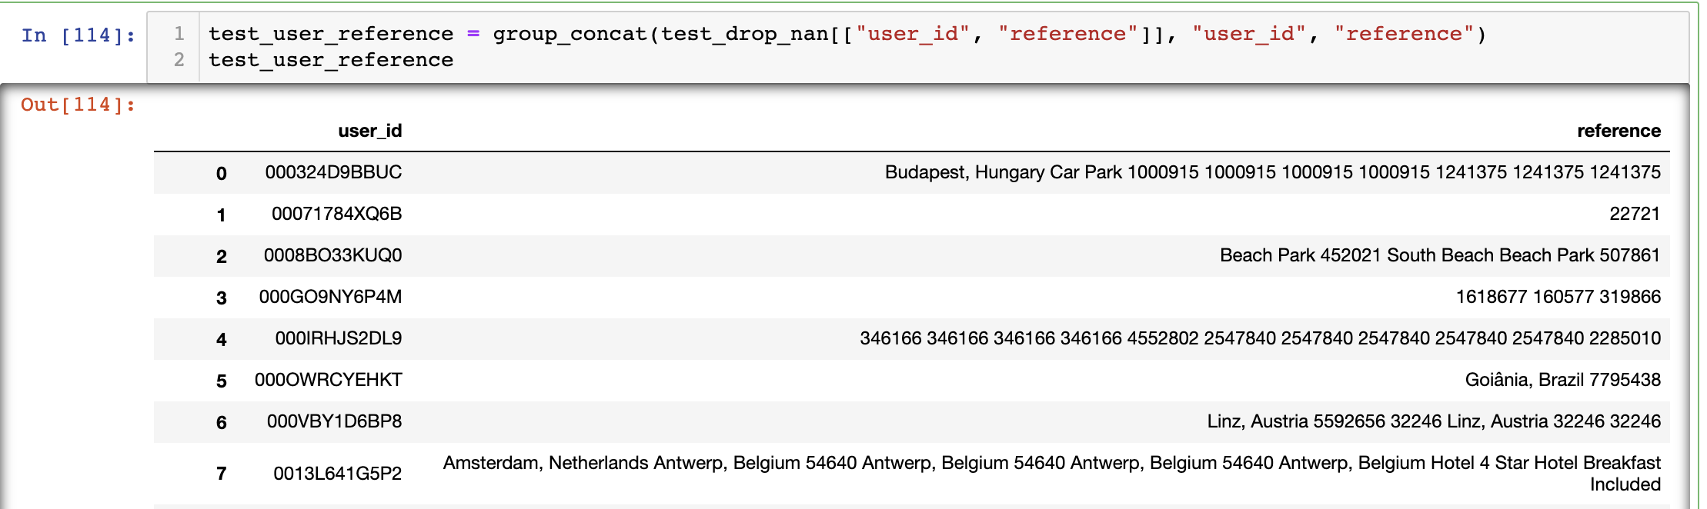
Put all the hotels a user has taken action on in a set, if the hotel is in the impression list, move that hotel to the top

Slide 12
Benefit:
Using set to store the actions can remove duplicate items, so save space
O(1) time to search if an item is in the set
Drawback:
Haven’t considered the order of actions

Slide 13
Assumption 2:
Actions taken in the last part of the sessions play more important roles
Solution:
Use a list to store all actions instead of using a set, the order of the items in the list is based on time order

Slide 14
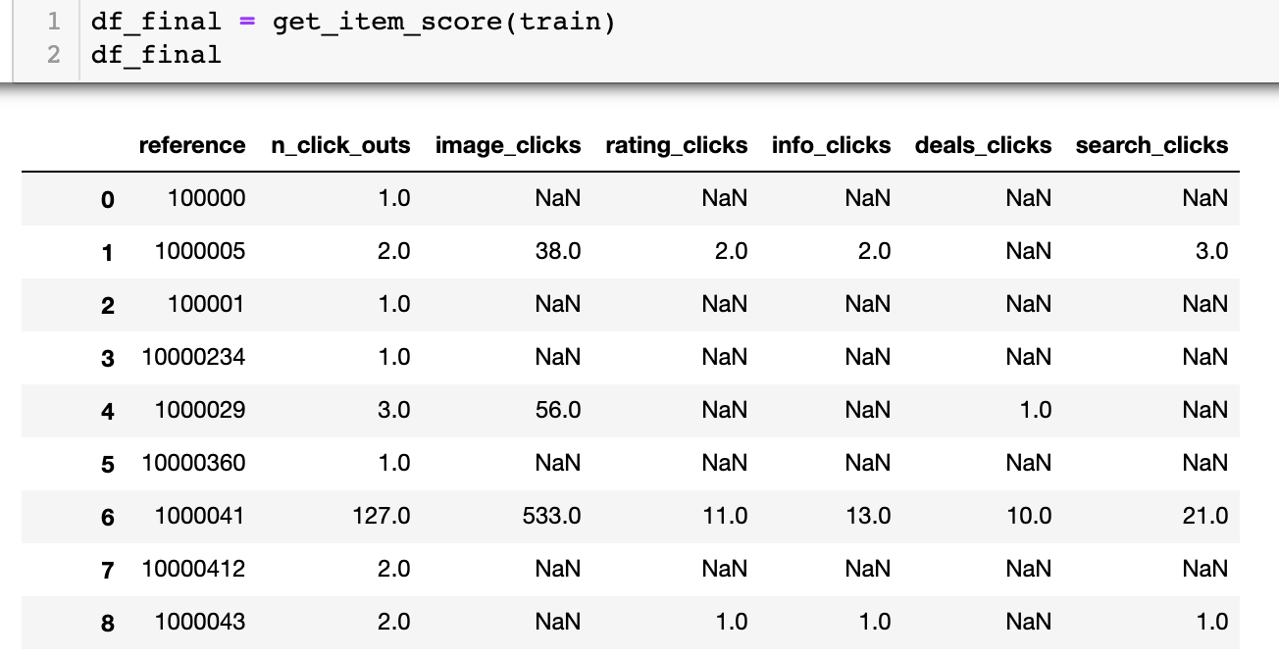
Assumption 3:
Popularity is not just based on “click_out”, other actions should also be considered

Slide 15
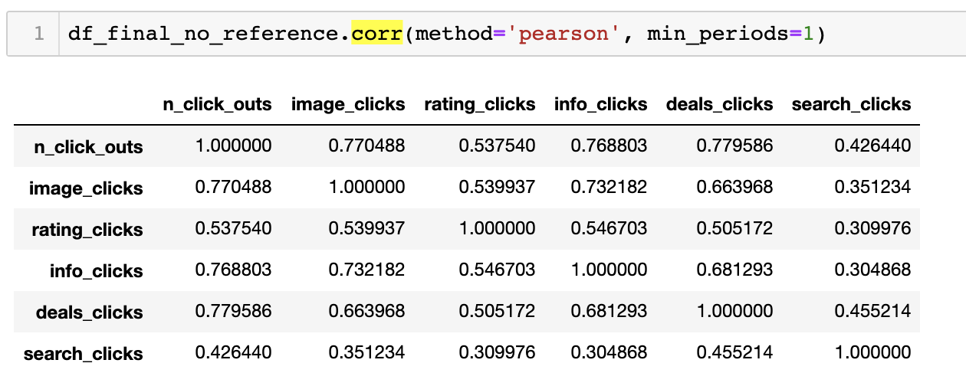
Consider the importance of each action:

Slide 16
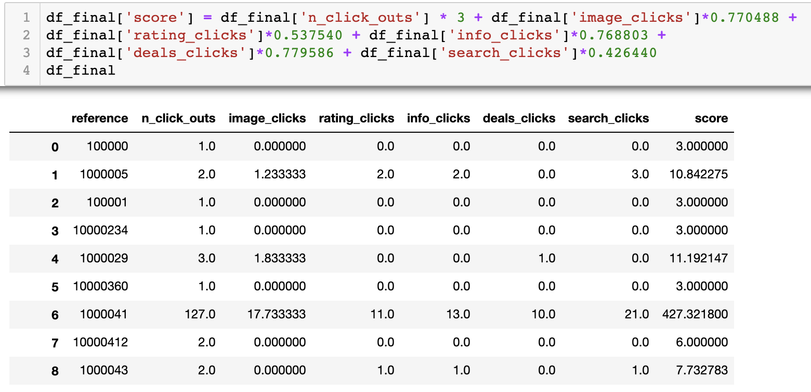
Calculate a weighted sum as a score for each item

Slide 17
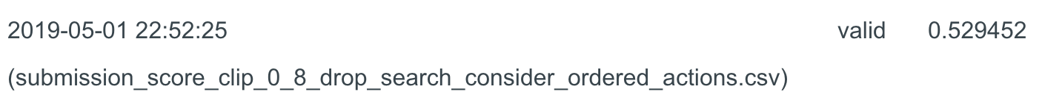
Use these scores, combined with the personal actions of each user
Next step:
How to use metadata?

